Slide 1

The National University of Computer and Emerging Sciences
Pointers to Arrays
CS 1002 Programming Fundamentals
Dr. Akhtar Jamil
Department of Computer Science

Slide 2
Goals
Introduction to Pointers

Slide 3
Relationship Between Pointers and Arrays
Effect:-
- List is an address, no need for &
- The bPtr pointer will contain the address of the first element of array List.
Element List[2] can be accessed by *(bPtr+2)

Slide 4
Arrays and Pointers
Array name is the starting address of the array
Let int A[25]; int *p; int i, j;
Let p = A;
Then p points to A[0] p + i points to A[i] &A[j] == p+j *(p+j) is the same as A[j]

Slide 5
Accessing 1-Demensional Array Using Pointers
We know, Array name denotes the memory address of its first slot.
Example:
int List [50];
int *Pointer;
Pointer = List;
Other slots of the Array (List [50]) can be accessed using by performing Arithmetic operations on Pointer.
For example the address of (element 4th) can be accessed using:-
int *Value = Pointer + 3;
The value of (element 4th) can be accessed using:-
int Value = *(Pointer + 3);
Address
Data
980
Element 0
984
Element 1
988
Element 2
992
Element 3
996
Element 4
1000
Element 5
1004
Element 6
1008
Element 7
1012
Element 8
…
…
1180
Element 49

Slide 6
Accessing 1-Demensional Array
Address
Data
….
….
int List [50];
int *p;
p = List;
p = p + 3;
*P = 293;
}
980
Element 0
984
Element 1
988
Element 2
992
293
996
Element 4
1000
Element 5
1004
Element 6
1008
Element 7
1012
Element 8
…
…
1180
Element 49

Slide 7
Accessing 1-Demensional Array
…
…
int List [ 50 ];
int *Pointer;
Pointer = List;
for ( int i = 0; i < 50; i++ )
{
cout << *Pointer;
Pointer++; //Address of next element
}
Address
Data
980
Element 0
984
Element 1
988
Element 2
992
293
996
Element 4
1000
Element 5
1004
Element 6
1008
Element 7
1012
Element 8
…
This is Equivalent to
…
for (int loop = 0; loop<50; loop++)
cout<<Array[loop];
1180
Element 49

Slide 8
Accessing 2-Demensional Array
In 1D array if we use:
int *Pointer;
Pointer = &List[3]; //accessing the // address of 4th slot.
In 2-Demensional array:
Address
Data
980
Element 0
984
Element 1
988
Element 2
992
293
996
Element 4
1000
Element 5
1004
Element 6
int main()
{
int A[3][3]={{1,2,3},{4,5,6},{7,8,9}};
int *p;
p=A[2];
cout<<"\nvalue of p= "<<*p<<endl; //outputs 7
return 0;
}
1008
Element 7
1012
Element 8
…
…
1180
Element 49

Slide 9
Accessing 2-Demensional Array
Full array traversal of 2D array:
Pointer access is faster as compared to 2D array notation (one address calculation as compared to [ ][ ] row and col addresses)
int main()
{
int A[3][3]={{1,2,3},{4,5,6},{7,8,9}};
int *p;
p=A;
for(int i=0;i<9;i++)
{
cout<<"\nValue of p= "<<*p<<endl;
p++; // or just cout<<*(p+i)
}
return 0;
}

Slide 10
Accessing 2-Demensional Array
int List [9][6];
int *ptr;
ptr = &List [3];
To access the address of 4th row 2nd column:
ptr++; // address of 4th row 2nd column
(faster than normal array accessing Why?)
Equivalent to List [3][1] ;
Column
0
1
2
3
4
5
0
300
302
304
306
308
310
1
312
314
316
318
320
322
2
324
326
328
330
332
334
3
336
338
340
342
344
346
Row
4
348
350
352
354
356
358
5
360
362
364
366
368
370
6
372
374
376
378
380
382
7
384
386
388
390
392
394
8
396
398
400
402
404
406
Array Index

Slide 11
Accessing 2-Demensional Array
We know computer can perform only one operation at any time (remember fetch-decode-execute cycle).
Thus to access List [3][1] element (without pointer) two operations are involved:-
First to determine row List [3]
Second to determine column List[3][1]
But using pointer we can reach the element of 4th row 2nd column (directly) by increment our pointer value (which is a single operation).
ptr+1; // 4th row 2nd column
ptr+2; // 4th row 3rd column
ptr+3; // 4th row 4th column
Column
0
1
2
3
4
5
0
300
302
304
306
308
310
1
312
314
316
318
320
322
2
324
326
328
330
332
334
3
336
338
340
342
344
346
Row
4
348
350
352
354
356
358
5
360
362
364
366
368
370
6
372
374
376
378
380
382
7
384
386
388
390
392
394
8
396
398
400
402
404
406
Memory address

Slide 12
Dynamic two dimensional arrays
Using a single Pointer
Total elements in a 2D Array:
m * n (i.e., rows * cols)
5 rows * 4 columns = 20 elements
Target Approach=
allocate 20 elements using dynamic allocation
Use a single pointer to point and access those items.

Slide 13
Dynamic 2D Arrays
#include<iostream>
#include <stdlib.h>
#include<time.h>
using namespace std;
int main()
{
int M=4; int N=5;
int* Arr=new int[M*N];
srand(time(0));
//set values
for(int i=0;i<M;i++)
for(int j=0;j<N;j++)
*(Arr + i*M+j) = rand()%100;
//display values
for(int i=0;i<M;i++) {
for(int j=0;j<N;j++) {
cout<<*(Arr + i*M+j)<<" ";
//cout<<(Arr+i*M)[j]<<" ";
}
cout<<endl;
}
delete[] Arr;
return 0; }
Notes:
int main(){
int *p= new int[5];
for(int i =0; i<5;i++)
cin>>*(p+i);
for(int i =0; i<5;i++)
cout<<" "<<p[i];
return 0;}

Slide 14
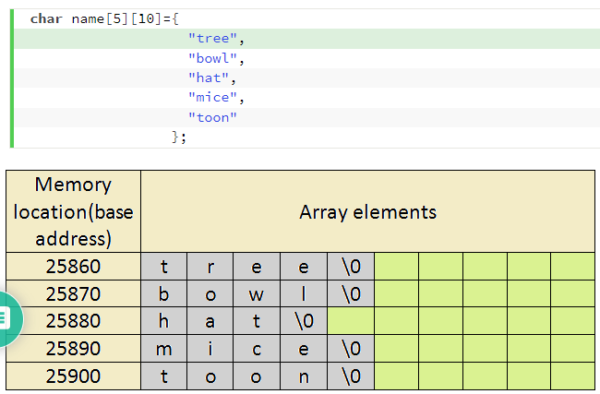

Slide 15
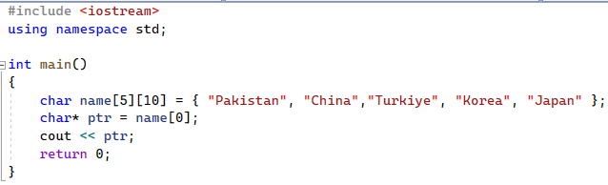
2D Char Array
Pakistan

Slide 16
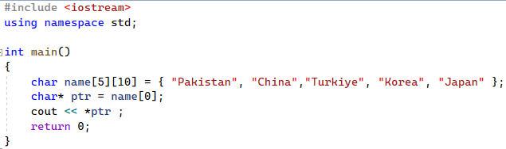
2D Char Array
P

Slide 17
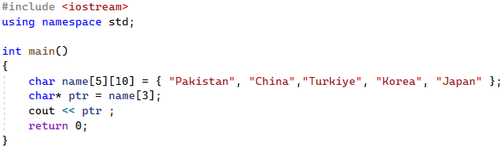
2D Char Array
Korea

Slide 18

2D Char Array
K

Slide 19
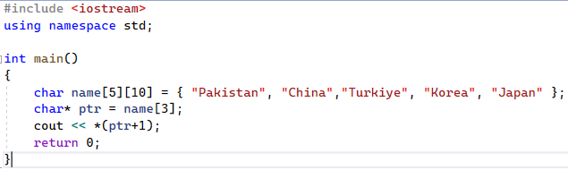
2D Char Array
o

Slide 20
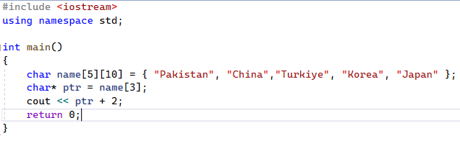
2D Char Array
rea

Slide 21
2D Char Array
rea

Slide 22
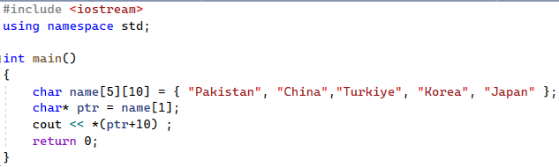
2D Char Array
T

Slide 23
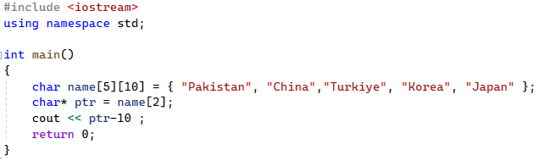
2D Char Array
China

Slide 24
References
Credit goes to Dr. Muhammad Aleem for preparation of slides
Chapter 20, Starting out with c++

Slide 25
Thank You ☺

